Slide 1

Operating Systems
Jinghui Zhong （钟竞辉）
Office：B3-515
Email ：jinghuizhong@scut.edu.cn

Slide 2

单选题
1分
A file system adopts a double indirect block allocation method. If the size of each block is 1KB and each disk block number is 4B, then what is the maximum length of a single file in the system（）
A
64MB
B
128MB
C
32MB
D
None of the above
提交

Slide 3
File System Performance
Block cache
Block read ahead
Reducing Disk-Arm Motion

Slide 4
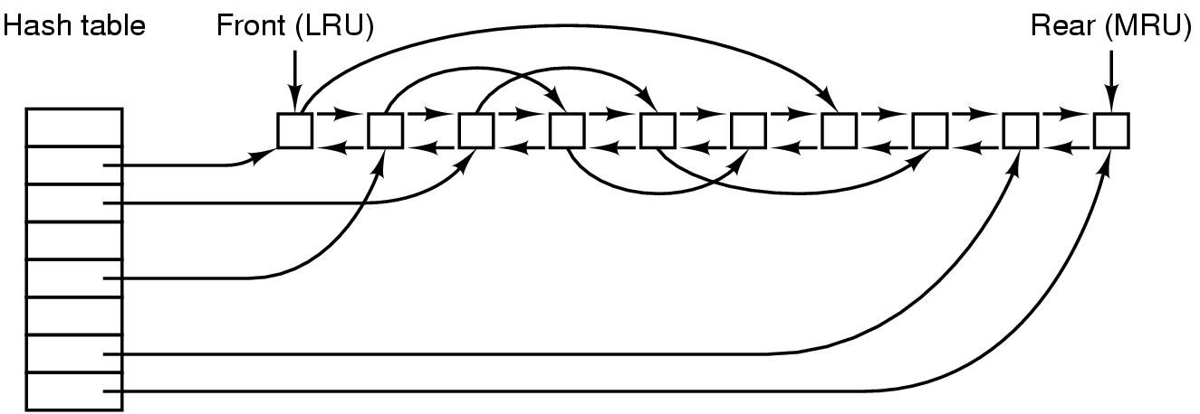
Block cache
A block cache or buffer cache is a collection of blocks that logically belong on the disk, but are kept in memory to improve performance.
All of the previous paging replacement algorithms can be used to determine which block should be written when a new block is needed and the cache is full.
Has the same hash code
4

Slide 5
Block cache
Periodically, all data block should be written out.
UNIX - system call sync forces modified blocks out to the disk immediately. e.g. update runs in background during sync every 30 seconds
Windows has a similar System call: FlushFileBuffer
MS-DOS - write-through cache => all modified blocks are written immediately.
e.g. write a 1K block one character at a time
UNIX collect them together
MS-DOS 1B at a time
5

Slide 6
单选题
1分
Disk block cache is in ()
A
Cache
B
Memory
C
Disk
D
Disk controller
提交

Slide 7
Block read ahead
Get blocks into the cache before they are needed
help increase the hit rate
suitable for sequential read;
not suitable for randomly accessed
waste disk bandwidth by reading in useless blocks and may remove potentially useful blocks from the cache;
7

Slide 8
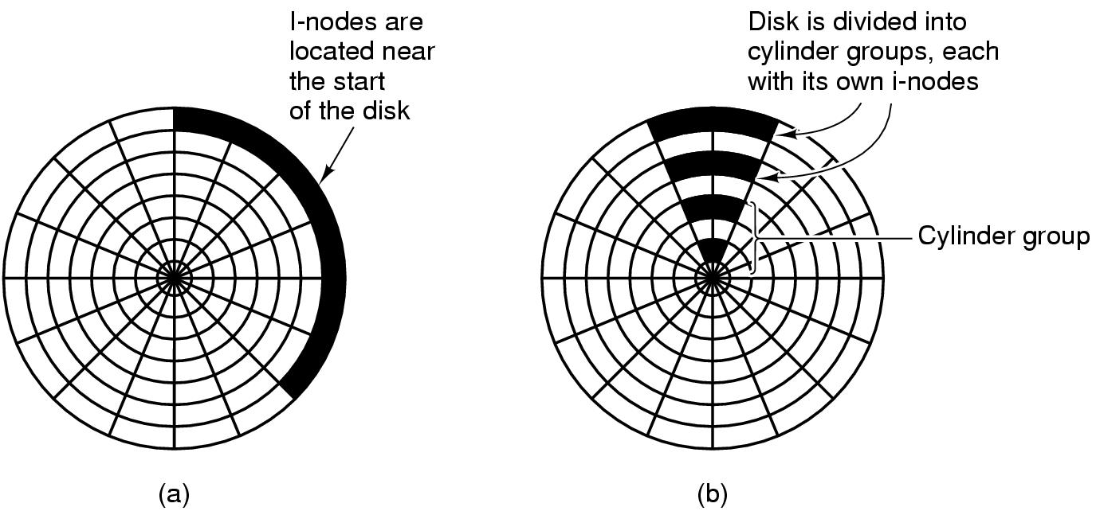
Reducing Disk-Arm Motion
Reading a block needs one access for the i-node and one for the block.
(a) I-nodes placed at the start of the disk
(b) Disk divided into cylinder groups, each with its own blocks and i-nodes.
Old method
New method
8

Slide 9
Defragmenting Disks
Fragmentation
Over time, files will be created and deleted, resulting in holes on the entire disk.
When a new file is created, the blocks used for it may be spread all over the disk, giving poor performance.
Solution
Moving files around to make them contiguous and to put all (or at least most) of the free space in one or more large contiguous regions on the disk.
Windows has a program, defrag. Windows users should run it regularly, except on SSDs.
9

Slide 10

Defragmenting Disks
10

Slide 11
单选题
1分
The main purpose of setting disk buffers in system memory is to ()
A
Reduce disk IO times
B
Implement device independence
C
Improve disk data reliability
D
None of the above
提交

Slide 12
单选题
1分
Which method could not improve the I/O performance of disk device?()
A
Reorder I / O requests
B
Set up multiple partitions on a single disk
C
Block Read ahead
D
Optimize file block distribution
提交

Slide 13
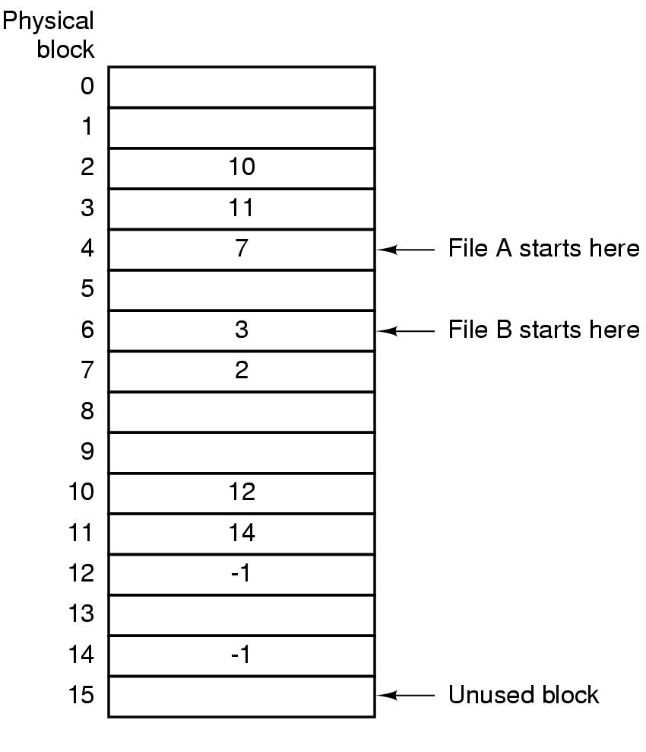
The MS-DOS File System
FAT-based method: take table pointer word from each block and put them in an index table, FAT (File Allocation Table), in memory.
13

Slide 14
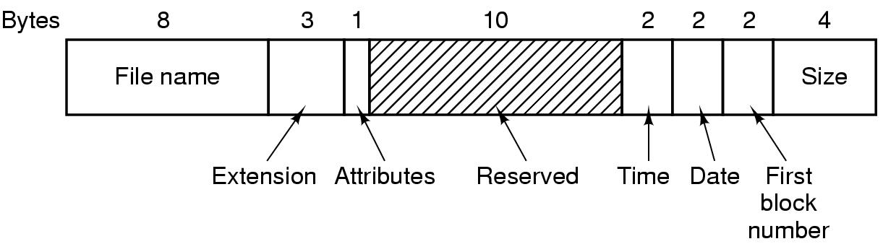
The MS-DOS File System
Many digital cameras and MP3 players use it.
Use a fixed-size 32 byte directory entry.
The MS-DOS directory entry
14

Slide 15
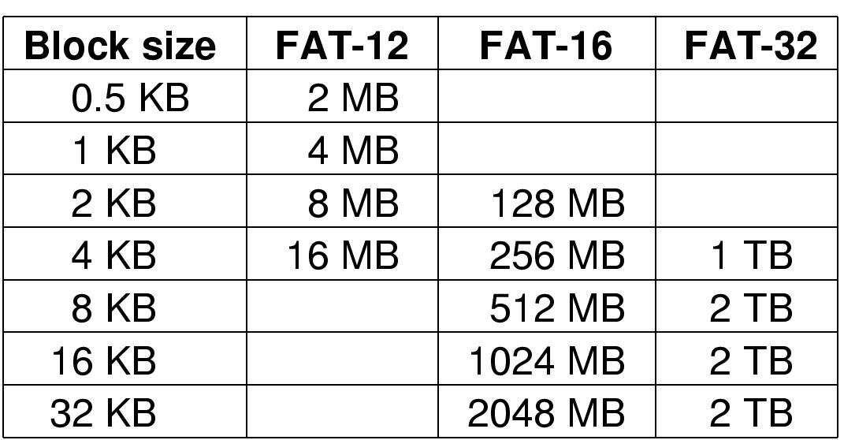
The MS-DOS File System
Maximum partition for different block sizes
The empty boxes represent forbidden combinations
15

Slide 16
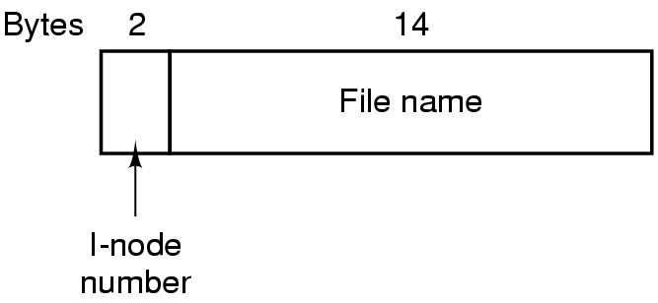
The UNIX V7 File System
A UNIX V7 directory entry
16

Slide 17
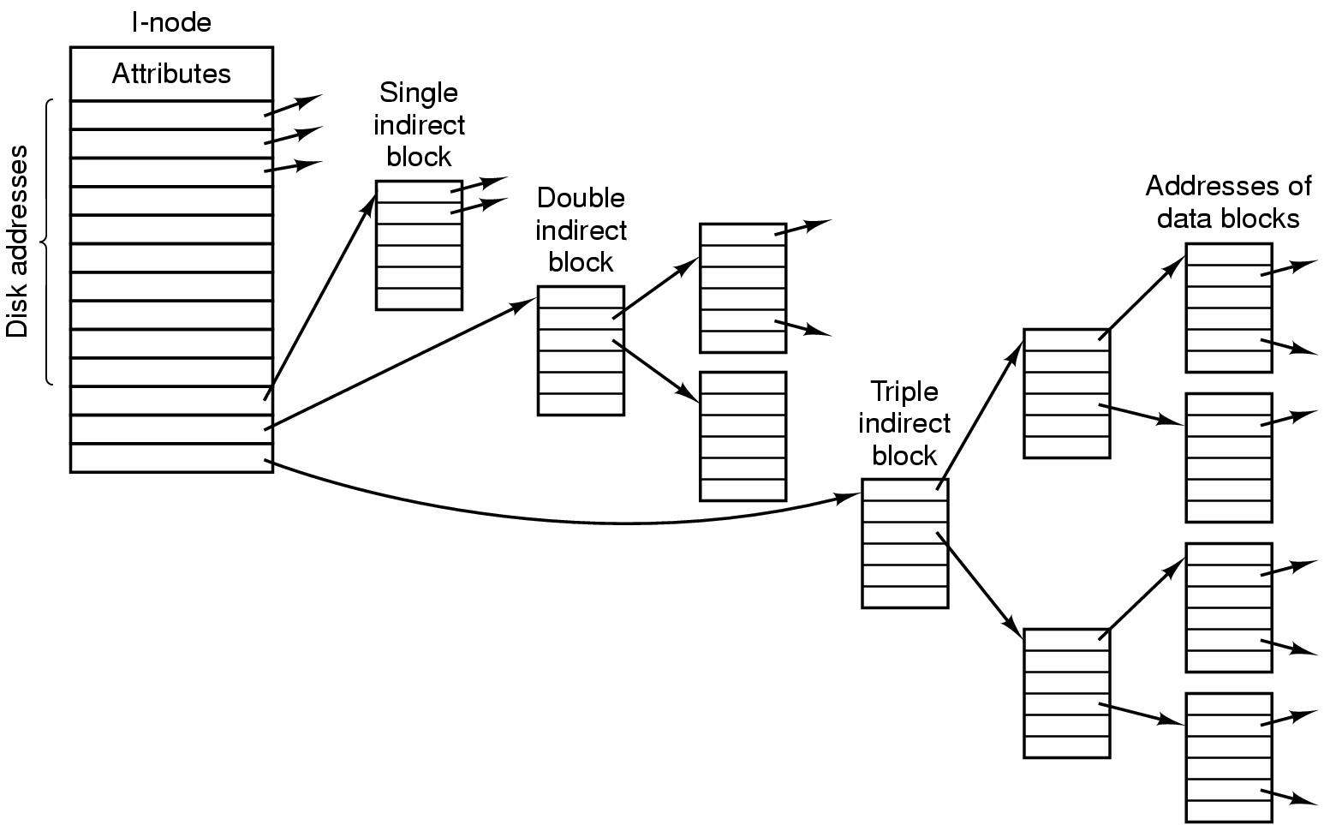
The UNIX V7 File System
A UNIX i-node
17

Slide 18
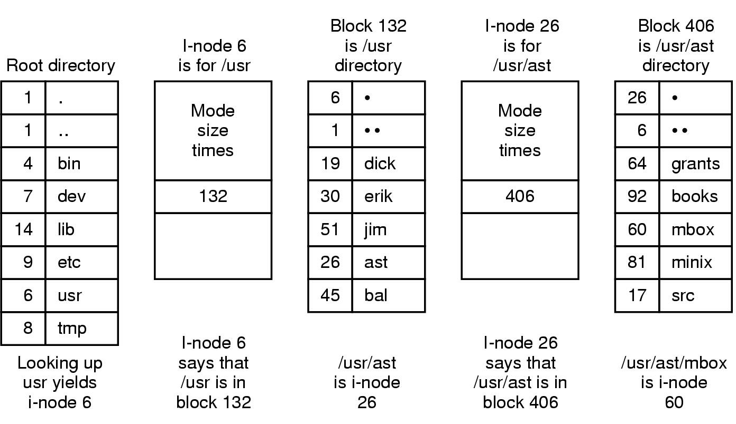
The UNIX V7 File System
The steps in looking up /usr/ast/mbox
18

Slide 19
主观题
1分
Suppose that each track of the disk is divided into nine blocks. There are nine record blocks in a file. The size of each record is equal to the size of the disk block. If the speed of the disk is 27ms /round, it needs 2ms processing time after each block is read. If other auxiliary time is ignored, and these records are stored on a track in sequence, the file processing program reads and processes the records in sequence and processes the files. How long will it take?
正常使用主观题需2.0以上版本雨课堂
作答

Slide 20
Suppose that each track of the disk is divided into nine blocks. There are nine record blocks in a file. The size of each record is equal to the size of the disk block. If the speed of the disk is 27ms /r, it needs 2ms processing time after each block is read. If other auxiliary time is ignored, and these records are stored on a track in sequence, the file processing program reads and processes the records in sequence and processes the files. How long will it take?
Answer:
The time of reading and processing each block: 27ms/9 +2ms= 5ms;
It take 27ms-2ms =25ms to start reading the next block.
So, the total time is: (25ms + 5ms)*8 + 5ms = 245ms;

Slide 21
主观题
1分
Suppose that each track of the disk is divided into nine blocks. There are nine record blocks in a file. The size of each record is equal to the size of the disk block. If the speed of the disk is 27ms /r, it needs 2ms processing time after each block is read. If other auxiliary time is ignored, and these records are stored on a track in sequence, the file processing program reads and processes the records in sequence and processes the files. How to store the records to minimize the processing time? What is the total processing time?
正常使用主观题需2.0以上版本雨课堂
作答

Slide 22
Suppose that each track of the disk is divided into nine blocks. There are nine record blocks in a file. The size of each record is equal to the size of the disk block. If the speed of the disk is 27ms /r, it needs 2ms processing time after each block is read. If other auxiliary time is ignored, and these records are stored on a track in sequence, the file processing program reads and processes the records in sequence and processes the files. How to store the records to minimize the processing time? What is the total processing time?
Answer:
A F B G C H D I E
(3ms +3ms)*8+(3ms + 2ms)= 53ms;

Slide 23
Security

Slide 24
The Security Environment：Threats
Goals and Threats:
Data confidentiality: Exposure of data
Data integrity：Tampering with data
System availability：Denial of service

Slide 25
主观题
1分
There are many ways to threaten the security of computers, among which data interception will threaten (A); modification and counterfeiting will threaten (B); and exhausting computer resources through virus will threaten (C).The main threat to computer hardware is (D).
Please write down the contents of A, B, C, D.
正常使用主观题需2.0以上版本雨课堂
作答

Slide 26
There are many ways to threaten the security of computers, among which data interception will threaten (Data confidentiality); modification and counterfeiting will threaten (Data integrity); and exhausting computer resources through virus will threaten (System availability).The main threat to computer hardware is (System availability).

Slide 27
Intruders
Intruder：people who nosing around places where they have no business
Common categories：
Casual prying by nontechnical users.
Snooping by insiders.
Attempts to make money.
Military espionage.

Slide 28
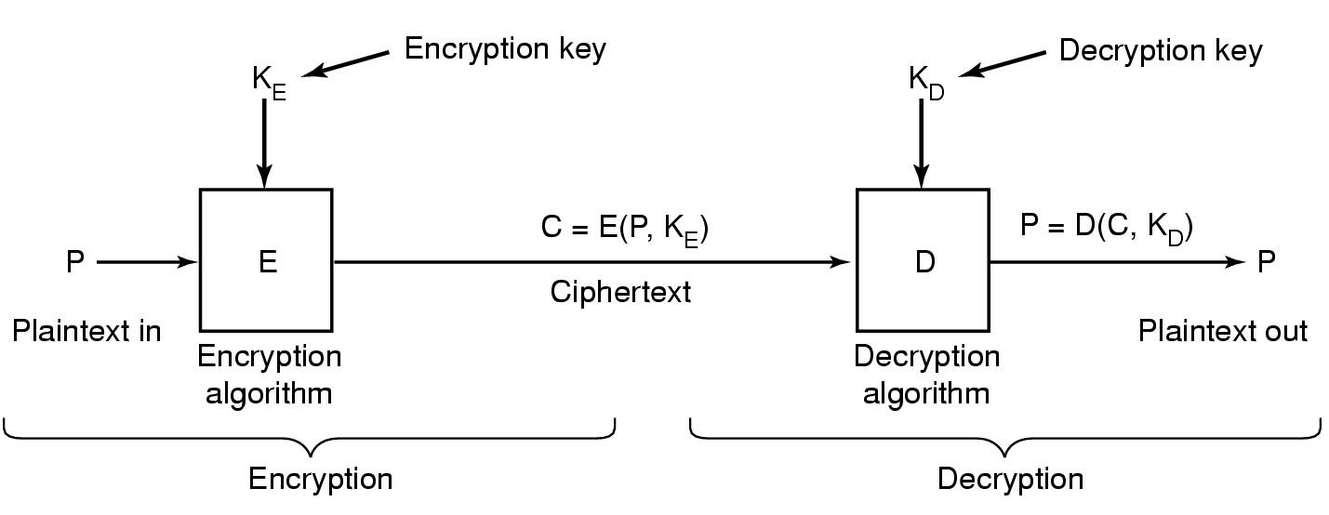
Basic of Cryptography
Encoding：C=E(P,K_{E})
Decoding：P = D(C, K_{D})
Kerckhoffs’s Principle：The algorithm should all be public and the secrecy should reside in the keys.
Relationship between the plaintext and the ciphertext.

Slide 29
Secret-Key Cryptography
Monoalphabetic substitution: replace every character by a new one using a key table.
e.g., ATTACK → QZZQEA
Secret-Key Cryptography is also called as Symmetric-key cryptography, for it is easy to find the decryption key given the encryption key, and vice versa.
The secret-key cryptography is relatively secure if the keys are long enough.

Slide 30


Slide 31
Public-Key Cryptography
All users use a pair of encryption key and decryption key. The encryption key can be made public and the private decryption key is kept secret.
Given a well-chosen encryption key, it is impossible to discover the corresponding decryption key.
Step 1：Sender uses encryption key to encode the doc；
Step 2：Receiver uses decryption key to decode the doc.
Drawback：requires a lot of computation cost.

Slide 32
Public-Key Encryption (RSA)
RSA: The most famous public-key encryption algorithm
One way function:
easy
$f\left(x\right)$ , where
f, x,
$$y=f\left(x\right)$$
Computational infeasible

Slide 33
Public-Key Encryption (RSA)
A fact: multiplying really big number is much easier for a computer to do than factoring really big numbers.
What are the factors of the composite number 1600000000000000229500000000000003170601?
80000000000000001239 and
20000000000000002559!!!

Slide 34
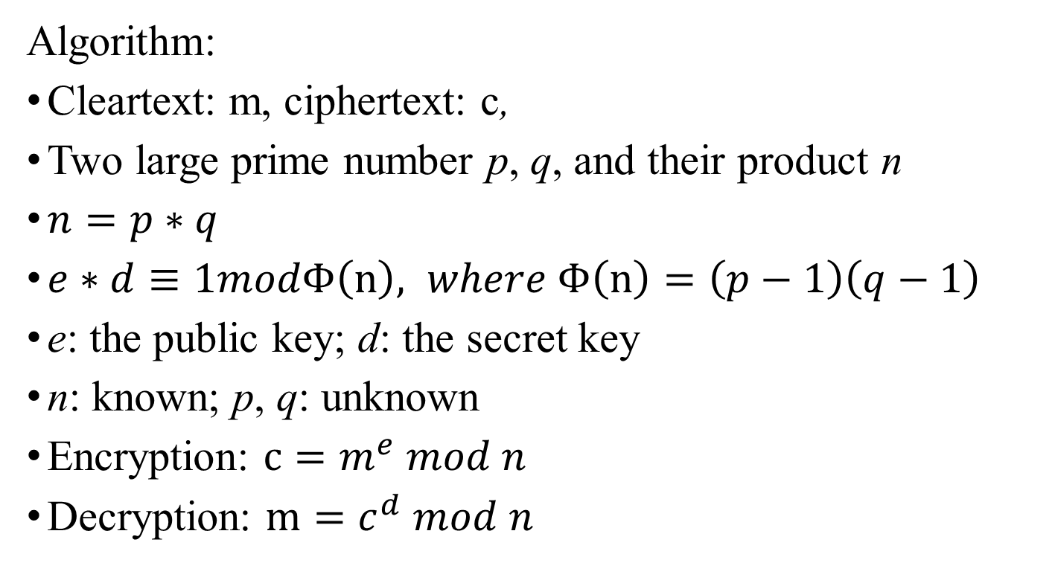
Public-Key Encryption (RSA)
Algorithm:
Cleartext: m, ciphertext: c,
Two large prime number p, q, and their product n
$n=p∗q$
$e∗d≡1modΦ\left(n\right), where Φ\left(n\right)=\left(p−1\right)\left(q−1\right)$
e: the public key; d: the secret key
n: known; p, q: unknown
Encryption: $c=m^{e} mod n$
Decryption: $m=c^{d} mod n$

Slide 35
Public-Key Encryption (RSA)
$$p=5, q=7$$
$$n=p∗ q=35$$
$Φ\left(n\right)=\left(p−1\right)∗\left(q−1\right)=4∗6=2$4
$$e=29, d=5$$
Public key:$p(e,n)=(29,35)$
Secret key:$p(d,n)=(5,35)$
【Practice】 try cleartext: 3

Slide 36


Slide 37
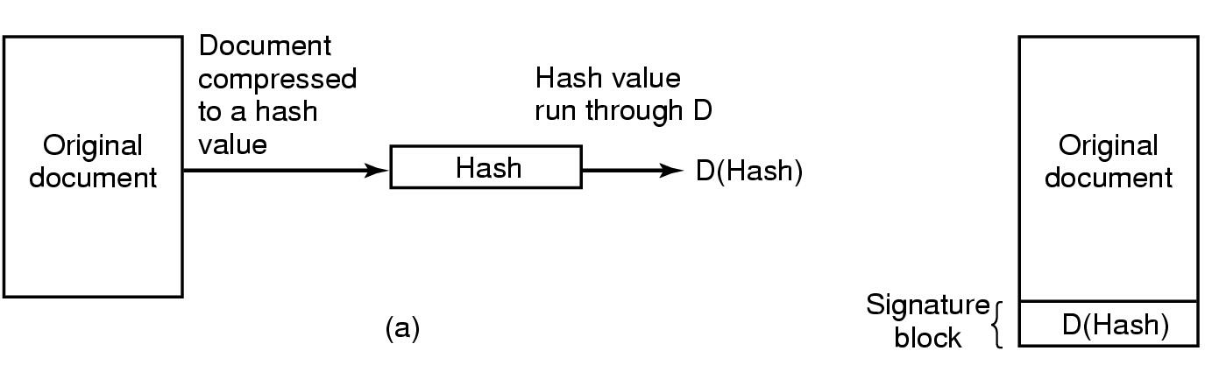
Digital Signatures
(b)
Step 1）Sender publics the encryption key and uses the decryption key to encode the hash value D；
Step 2）Receiver use the encryption key decode D and compare it with the calculated hash value. If the value are consistent, then accept.

Slide 38


Slide 39
主观题
1分
Please compare the difference between symmetric encryption algorithm and asymmetric encryption algorithm from multiple perspectives 。
正常使用主观题需2.0以上版本雨课堂
作答

Slide 40
Differences between symmetric encryption and asymmetric encryption
perspectives | symmetric | asymmetric
Confidentiality | The key needs to be kept secret, so the key transmission needs a reliable channel | The public key does not need to be kept secret and can be transmitted through the general communication environment, while the private key does not need to be transferred
Key quantity | The number of keys is large and difficult to manage, n (n-1) / 2 | The number of keys is greatly reduced, 2n
Encryption speed | Fast, Suitable for encryption of large amount of data | slow
Communication between unknown users | N/A | Yes
Digital Signatures | No | Yes

Slide 41
主观题
1分
A and B strange to each other try to establish communication via private keys, but they don’t share private keys. If both A and B trust a third party C whose public keys are known by all people, how can A and B agree on a new private key to establish communication?
正常使用主观题需2.0以上版本雨课堂
作答

Slide 42
A and B strange to each other try to establish communication via private keys, but they don’t share private keys. If both A and B trust a third party C whose public keys are known by all people, how can A and B agree on a new private key to establish communication?
General idea:
1）A send encrypted private keys to C, and ask C to tell B send his private keys to C.
2）C send A’s provide key to B using B’s private key. Then A and B can communicate with each other using the same private key.

Slide 43
Authentication
Basic rules：
Unique authentication
Be accomplished before users get access to the system
Three principles：
Something the user knows
Something the user has
Something the user is
Notes:
验证必须唯一
验证必须在用户能够使用系统前做

Slide 44
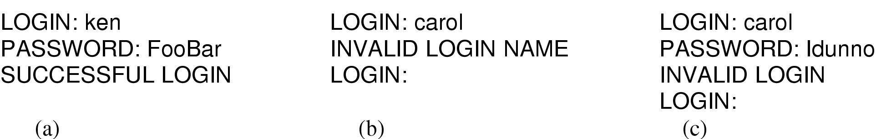
Authentication Using Passwords
(a) A successful login.
(b) Login rejected after name is entered.
(c) Login rejected after name and password are typed.
BIOS invation

Slide 45
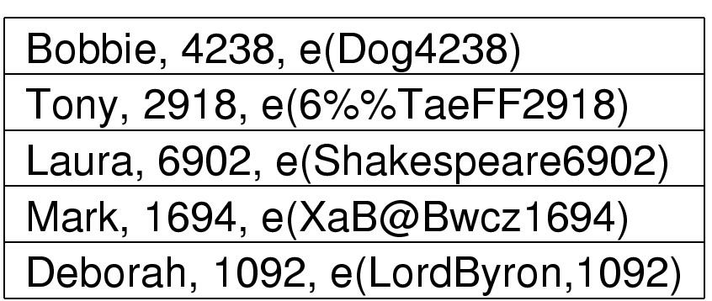
Authentication Using Passwords
Store the encrypted file；
The use of salt to defeat precomputation of encrypted passwords
,
,
,
,
salt
password
Update passwords periodically

Slide 46
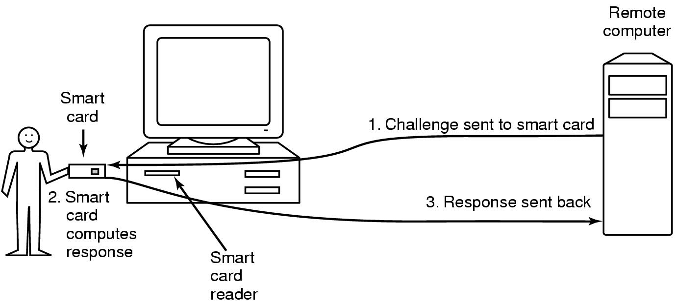
Authentication Using a Physical Object
To check for some physical object users have,
e.g. magnetic stripe cards, magcards, IC cards

Slide 47
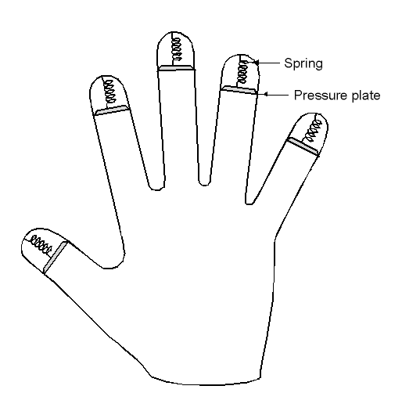
Authentication Using Biometrics
Measures physical characteristics of the user that are hard to forge.
A device for measuring finger length.

Slide 48
Insider Attacks: Logic Bombs
Logic bomb: Programmers in companies may hide bugs in the programs on purpose,
e.g., a device which does nothing as long as the programmer feeds it its daily password while goes off after the programmer gets suddenly fired and not feeds it the next day.

Slide 49
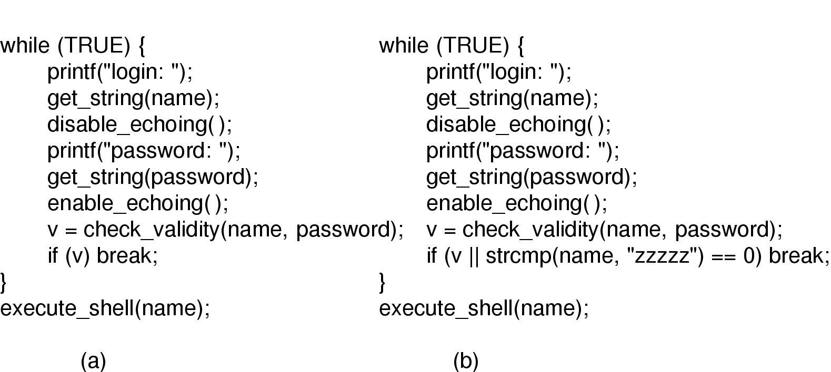
Insider Attacks: Trap Doors
Trap door: a piece of additional code inserted into the program so as to bypass some normal check.
(a) Normal code. (b) Code with a trap door inserted.

Slide 50
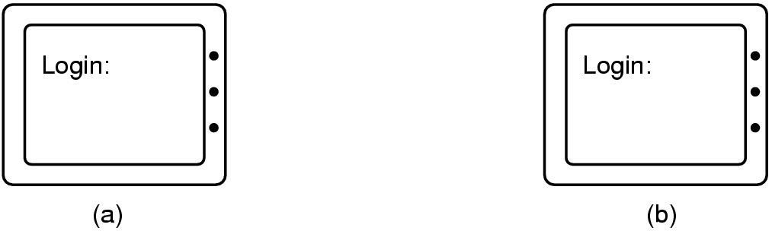
Insider Attacks： Login Spoofing
A way of stealing users’ login names and passwords by providing a similar but fake login window
The fake login window looks amazingly the same as the true one!

Slide 51
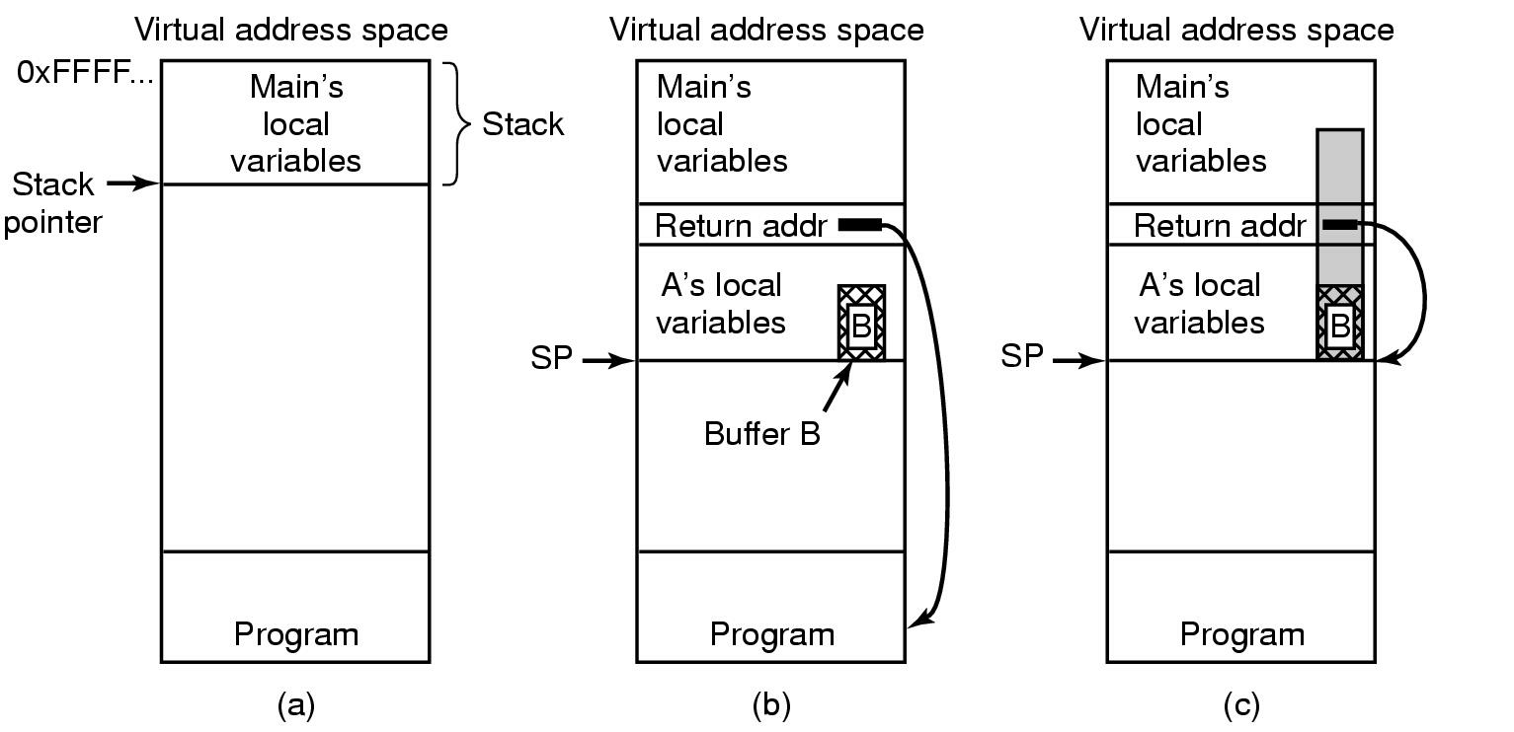
Outsider Attacks: Buffer Overflow Attacks
(a) Situation when the main program is running.
(b) After the procedure A has been called.
(c) Buffer overflow shown in gray.

Slide 52
主观题
1分
In the computer system, there are many kinds of technology for identity authentication, among which password technology is based on () authentication, IC card is based on () authentication, fingerprint identification is based on () authentication.
A: user characteristics;
B: user's property;
C: Things the user knows;
D user's privilege;
正常使用主观题需2.0以上版本雨课堂
作答

Slide 53
In the computer system, there are many kinds of technology for identity authentication, among which password technology is based on (C) authentication, IC card is based on (B) authentication, fingerprint identification is based on (A) authentication.
A: user characteristics;
B: user's property;
C: Things the user knows;
D user's privilege;

Slide 54
多选题
1分
Which statement about digital signature is correct? （）
A
The receiver can verify the sender's signature on the message
B
The receiver can verify whether the received information has been modified by others during transmission.
C
The sender cannot repudiate the signature of the message afterwards
D
The receiver cannot forge the signature of the message
提交

